Slide 1
Whole-Cell Analysis
Demonstrations
Whole-cell Assays
Experimental Design
Notes:
Today we’re discussing Whole-Cell Analyses. These are the methods used to extract information about a genetic composition starting with intact cells. We’ll discuss demonstration experiments, whole-cell assays, and experimental design.

Slide 2
The DBTL cycle
Design
Build
Test
Learn
Notes:
More generally, we are discussing a subset of concerns related to the Test phase of the design build test learn cycle. When you go to do a genetic engineering experiment, you will start with Design. You will decide the composition of your strains in terms of what genes will used in the project, which combinations of those genes go into each strain composition, what regulatory elements you will add, and whether you want to put the genes on a plasmid or in the genome, and which plasmids and which sites in the genome. For each design, you will generate construction files describing how to go about fabricating the strains described by your composition designs. You then enter the build phase where you do all the oligo synthesis, gene synthesis, assembly, and transformation needed to construct your strain. You then enter test, the subject of our lecture today, in which you take measurments on the cells to extract information about the function of your design. In the Learn phase, the experimental data is interpreted and information is encapsulated for use in the next round of design. As of 2014, this process is all done in peoples heads. However, much of the software infrastructure needed to automated every step of this cycle is almost mature and will be deployed in early 2015.

Slide 3
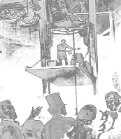
The Demonstation
System Characterization
Branding
Notes:
A demonstration experiment involves testing a system in a context close to its real-world usage in a manner that highlights the its features, and demonstrates the absence of undesirable features. It involves system characterization of the complete system in a context similar to its real world usage. It is often disregarded as cheap advertising, and indeed is highly useful for branding an invention. However, the utility of a demonstration goes beyond this. The image here is of Otis, of elevator fame, who was demonstrating their new safety system that involved a mechanism that locked the elevator car in place if the hoisting ropes fail. He gathered a crowd of people around as he stood on the elevator platform, and then he cut the rope. Instead of plunging to his death, the safety mechanism kicked in.
Now, he could have instead written a report that quantified the load capacity of the breaking mechanism, shown statistics on its rate of failure under test conditions, or provided simulations of the failure process. However, for the goals of introducing a product, the more direct demonstration is far more tangible and powerful. By doing the demo live and in person, he is showing that he is willing to trust his life to the invention, and in the process is inducing emotions of anticipation and foreboding in his audience members minds. Thus they are paying attention, and when the device does not fail, the memory of the experiment is far more tangible than if they read a report. This is not to say that the report should not be generated – some people will want a more technical specification about the performance of this device. However, the report alone is far less compelling than the dramatic demonstration. Technical reports are only comprehensible to an expert in the subject, and whether the report means the system works well or not is often intangible to a general audience. However, the demonstration is immediately tangible and communicates exactly what the general audience wants to know: If I use an Otis elevator, and the rope breaks, I won’t die.

Slide 4
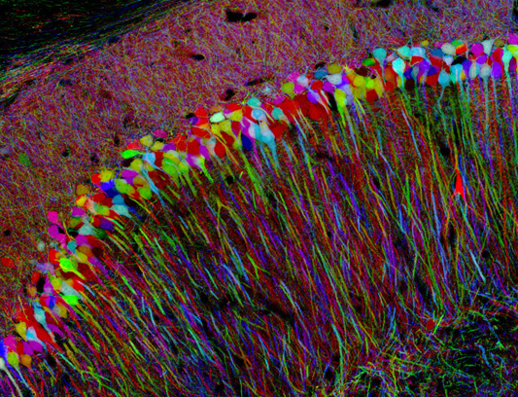
The Brainbow
Notes:
Demonstrations are also common in the genetic engineering space. Often they employ beautiful images and videos to entice the reader’s attention. In this example, we are looking at a false-color rendering of the Brainbow. The Brainbow was a genetic circuit composed of three fluorescent proteins randomly expressed at several distinct expression levels. A transgenic animal encodes the device, and each neuron of its brain will express one combination of the fluorescent proteins at specific levels. Each neuron then has a unique signature relative to its neighbors in terms of the relative fluorescence on the three channels. When they do microscopy on slices of the brain material, they can quantify each channel, determine which combination of levels are present in each cell, and assign a color specific to that combination. They then false-color the image to generate what is shown here.

Slide 5
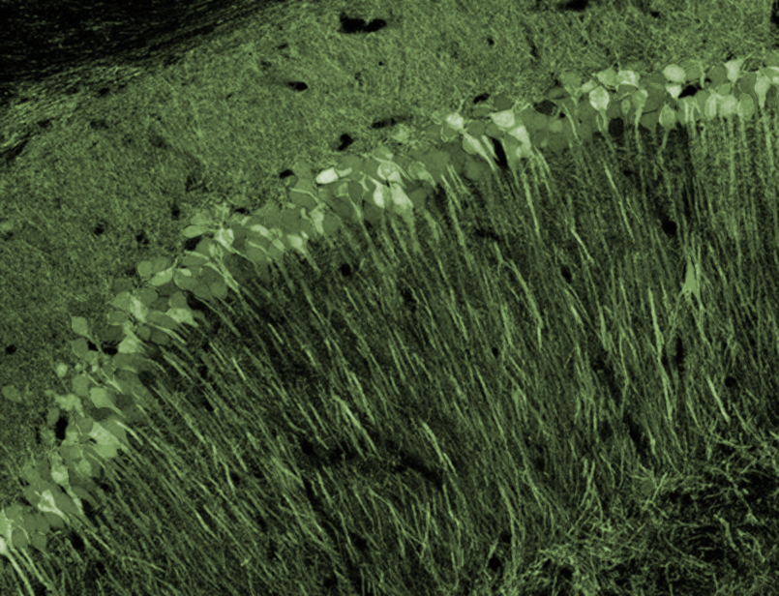
The Brainbow
Notes:
In reality, what the scientists probably saw under a microscope looked something like this. And they could have published that image, and the technical merit and utility of the technique is in no way compromised. They could have provided graphs showing statistics about how well they can distinguish two cells, or other more technical measures of performance. However, without the false coloring the ability to distinguish the neurons is not communicated, and the utility of the technique would be lost. It might be understandable to software, but this ability is not communicated without the false-color contrivance. Additionally, the technique is simply not as tantalizing and interesting as when they produce the beautiful image.

Slide 6
The Brainbow
Notes:
The colorful version communicates to the reader not only that this labeling method allows the tracking of individual cells, but you also get an impression for how well this methodology can distinguish the axons of one cell from another.

Slide 7
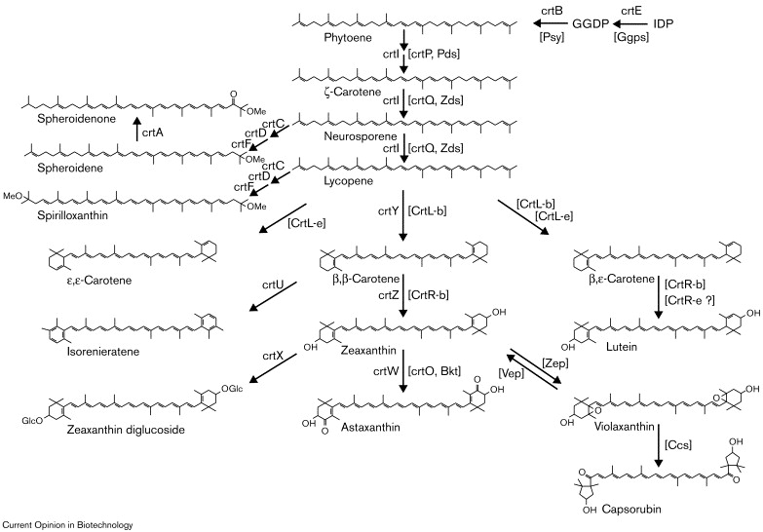
Carotenoid Biosynthesis
Notes:
Here is another study by Francis Arnold. They are expressing combinations of carotenoid-related genes in E. coli to explore the chemical diversity of biosynthesis.

Slide 8
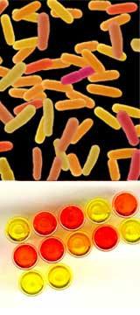
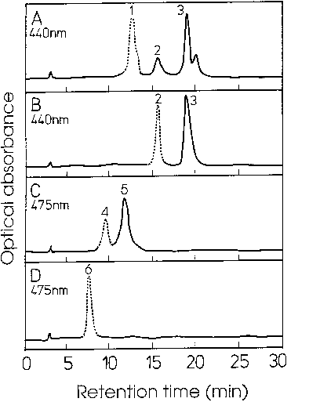
Carotenoid Biosynthesis
Francis Arnold
PMID: 10888843
Notes:
Experimentally, they put a different combination of genes into each cell, grow it up, extract the carotenoids, run them on a chromatography instrument, and report the spectrum. Technically, this is the experiment that they need to perform to quantify yields and identify the chemicals present in each strain. However, they also provide a demonstration experiment.
*
They show images of the population of cells and what the plates look like when you grow up individual library members. This provides no additional quantitative information beyond what is present in the chromatography traces, however, the data is far more interesting to look at and communicates less tangible aspects of the system. The image of individual bacteria in a field illustrates without any verbal explanation that they are creating diversity of yellow, red, and orange phenotypes. The cells are producing sufficient pigment to be obvious by eye. With traces alone, the interpretation that the amount of pigment is sufficient for human visualization is not readily apparent without doing some math. With the image, it is obvious. Visually, we also can tell that they are not generating greens and purples in their experiment – it has a limited scope. As they say, a picture is worth a thousand words. In this case, there are two different images that convey different qualities of the system. The demonstration experiment provides framing to the project, information about the diversity that results, and makes the phenotypes they have generated tangible to the reader.

Slide 9
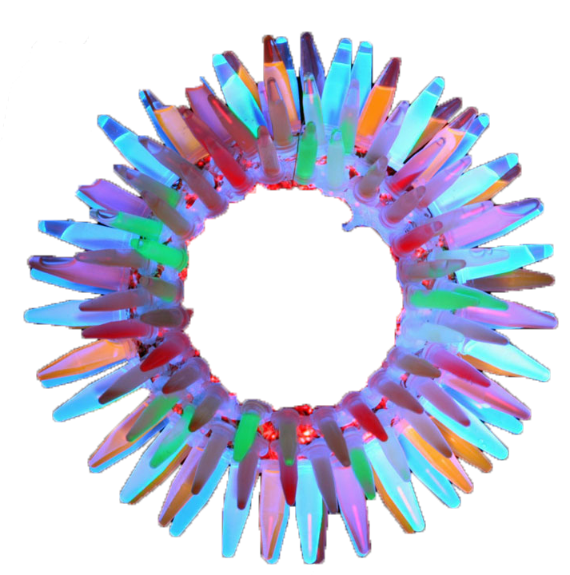
Fluorescent Proteins
Roger Tsien
(pubmed Tsien RY)
Notes:
Here is another experiment from Roger Tsien. He is trying to communicate the diversity of phenotypes that can be produced using different variants of GFP and RFP. The technical experiment involves measuring the excitation and emission spectra of the variants. Unless I am accustomed to mapping wavelengths onto colors, it is not immediately obvious what the actual diversity is here. Is this a narrow range of shades-of-green, or is this the full spectrum of color diversity? If I want to choose a GFP that emits a specific wavelength of light, I would want this technical data to make my choice. However, if I just want to understand the scope of what is available,
*
A demonstration experiment is far more compelling. Like with the carotenoid example, I can readily tell that these phenotypes are visual with the naked eye, that they span the visible color range, that there is some variation in intensity, but all are in the same ballpark of intensity. Additionally, the image is beautiful and simply interesting to look at.

Slide 10
Biofuel-Producing Yeast
Build a biorefinery
Put the yeast into a bioreactor
Give it some cellulose-derived carbon source
Collect the biofuel
Show how much it cost to make a barrel of biofuel
or…
Run a car on biofuel
or…
Show images of cultures with a layer of biofuel floating on the surface
or…
Light a culture of the bacteria on fire
Notes:
Let’s look at a more current example. Suppose we want to make Biofuel-producing yeast. For technical characterization, we will need to build a biorefinery, put the bugs into it and grow it up at scale using cellulose or sugar as a carbon souce, collect the biofuel, and then compute the cost of producing it. If I were an investor, I would want to know this quantitative technical information to be confident that the company can produce a commercially-viable product. However, it’s just going to look like a page of numbers to the non-expert. Additionally, the company might be hiding details such as the presence of a contaminant in the fuel that makes your car smell like rotten eggs.
*
A real world demonstration might be to run a car on the biofuel. In this way, they can show that the car runs just fine, that there aren’t obvious bad smells, and that it is a product indistinguishable from normal fuel.
*
Or, at an early phase of develop the company might how an image of the culture after fermentation under a microscope showing how the fuel separates from the medium in blobs.
*
Or, they might put the culture in a flask and light it on fire. All three of these demonstration experiments have been performed during the course of biofuel research, and they answer less technical questions about the technology, and do so in a way that better communicates the technology to their audience.

Slide 11
Artificial Pancreas Cells
Find a mouse diabetes model
Treat it with the Artificial Pancreas cells
Compare treated mouse insulin levels to those of untreated mice
or…
Show happy treated mice running on a treadmill
Notes:
Here’s another example. Suppose you want to make genetically-engineered cells to replace those that have been killed in patients with diabetes. The technical experiment would involve identifying a mouse diabetes model, performing the treatment with the engineered cells, and then quantifying insulin levels in treated and untreated mice.
*
In addition, taking a video of the mice running around on a treadmill after treatment demonstrates to the audience that not only are insulin levels normal, but the mice more overtly seem normal. They don’t look fatigued, have weight problems, wounds, or other abnormalities.

Slide 12
Designing a Demonstration
What is the closest experiment you can get to the “real world” use of this organism?
What demonstration experiments are necessary to show that “unwanted” behavior is absent in the system?
Is there any interesting in a sensory way (visual, smell, audible, etc.) that will illustrate the functioning of the system?
Notes:
When developing a new technology, it will always be valuable to think about what experiments would make good demonstations. There will always be additional, more technical experiments that you need to perform to show that specific attributes of your system work as intended, but this is no substitute for the demonstation. You should ask yourself, What is the closest experiment you can get to the “real world” use of this organism?
What demonstration experiments are necessary to show that “unwanted” behavior is absent in the system?
Is there any interesting in a sensory way (visual, smell, audible, etc.) that will illustrate the functioning of the system?

Slide 13
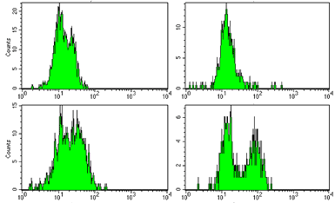
Fluorescent Reporter Assays
Notes:
The most commonly used whole-cell assay involves the measurement of fluorescence.

Slide 14
Fluorescent Reporter Proteins
RFP
GFP
BFP
YFP
RFP
Luciferase (Luminescence)
Fluorescent proteins
Notes:
Though there are additional ways of making a cell fluorescent such as using caged fluorophores and enzymes that deprotect them, the most common way of making a cell fluoresce is to express a gene encoding a fluorescent protein. There are a small number of ancestral fluorescent protein genes that have been isolated from jellyfish and other marine organisms. However, they have been extensively mutated to create additional genes with altered properties. There are many variants of GFP and RFP today with different spectral propertie. For example, YFP is a mutant of GFP that emits yellow light instead of green. Also, there are mutants that fluoresce only in the presence of calcium ions. This is only the tip of the iceberg of fluorescent proteins that exist now, but the main point is that these can be expressed in many types of cells and can fluoresce at wavelengths that the cells do not normally generate. Thus, these signals can be readily quantified on intact cells using various fluorescence measurements.

Slide 15
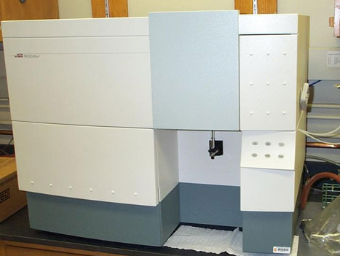

Cytometry
Primarily used for mammalian cells, but can be used for bacteria/yeast
FACS (fluorescence activated cell sorting) is something different—it recovers the cell population you want
Experiment generates a long list fluorescent measurements taken on single cells (each cell gets multiple measurements)
Requires a fluorescent protein or surface labeling of cells with a fluorescent probe
Measure fluorescence(s), side-scatter and forward-scatter for each cell as it passes through a light beam
Notes:
One workhorse instrument for measuring fluorescense is cytometry. Here, a dilute sample of cells is passed through a flow chamber. A laser is directed at a specific region of space along this chamber. Since the cells are dilute, only one cell passes through the laser at any given time. If that cell is fluorescent due to the expression of a fluorescent protein or surface labeling with a fluorophore, the cell will emit light as it passes through the laser. The wavelength of that emitted light will be red-shifted relative to the laser’s wavelength, so it is easily detected. Additionally, the cell will scatter the laser light in directions other than its original vector. These signals are quantified by placing detectors at alternate angles to the incident beam. Thus, each cell gives a side-scatter signal, a forward-scatter signal, and one or more fluorescence signals depending on the instrument setup.
*
Cytometers are primarily designed to work on mammalian cells, but they can also be used for bacteria or yeast cells, though the data is less precise. FACS, or fluoescence-activated cell sorting, is an instrument that adds functionality to a cytometer. As the cell passes through the laser, a FACS machine can deflect the cell into different collection bins based on the signals that are observed. Thus, a FACS machine will sort your cells while a cytometer only takes measurements of your cells. The output of a cytometer is a list of measurement events for each cell that was detected going through the cytometer. Each event is accompanied by a forward scatter, side-scatter, and fluorescence value presented as a number.

Slide 16
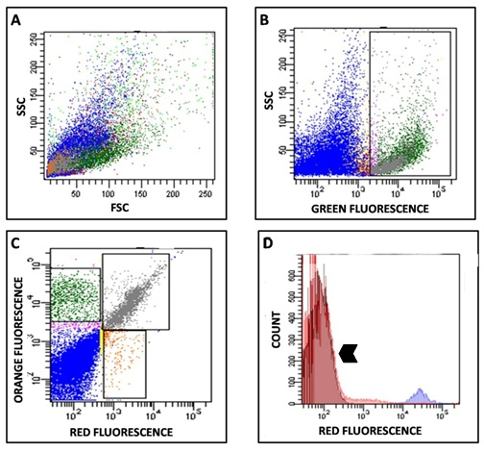
Cytometry Data
Notes:
It is very rare to look at the raw data from a cytometry run. There are typically 10,000 events are more in the dataset requiring the use of visualizations to be meaningful. Here is a typical series of visualizations. Panels A, B, and C are each dot plots, while D is a histogram.

Slide 17
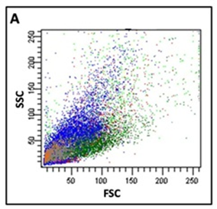
Cytometry Data
Dot Plot—each dot represents one event (presumably a cell)
Plot any combination of 2 measurements
Can “gate” based on choosing a region of a scatter plot
Notes:
Each dot in the chart represents one cell that passed through the laser. In each plot, the axis are two different signals. In A, it is side scatter versus forward scatter. These scatter measurments are related to the size and shape of the cell. With mammalian cells, these signals are more clustered. For bacteria, as shown here, there is a cone of responses primarily as a result of their smaller size, but also their rod shape – there is more surface area to scatter off of if the bacterium passes through the laser side-on rather than end-on. I

Slide 18
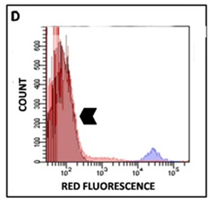
Cytometry Data
Histogram—number of counts at each level of fluorescence
Can plot for any 1 measurement
RFP intensity is X axis, Y axis is how prevalent that is in the sample
Is usually plotted on a semi-log scale
Can also calculate averages/stdevs from data
Notes:
In panel D, we have a different type of plot called a histogram. Here we plot the number of events that were observed for a narrow range of measured values. Here they are computing the distribution of red fluorescense measurments within the population. So, a dot plot compares two different measurements, while a histogram shows the distribution of only one measurment.
Typically fluorescense measurements are presented on log scale due to the wide range of signals, and the low precision of the measruements. Though the value observed during any single event has low precision, many events can be averaged together to get more confident values.

Slide 19
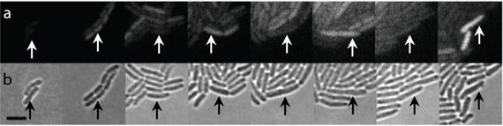
Fluorescence Microscopy
Loosely immobilize bacteria on an “agar pad” on a slide
Excite with a laser and take images/videos of fluorescence
Lower throughput, lower precision than cytometry
Allows timelapse measurements on a single population of bacterium, whereas cytometry only works for a single timepoint per cell
Can do multiple colors
Can do sub-cellular localization
Can see morphological changes
Can correlate morphological variation with fluorescence variation
Can track the heredity of fluorescence activity
Like Cytometry, requires normalization of signal, but not normalization of optical density
Notes:
Another common way of measuring fluorescence is to use microscopy. In this experiment, the engineeris loosely immobilize bacteria on an “agar pad” on a slide. They then excite with a laser and take images or videos of fluorescence. Microscopy has lower throughput and lower precision than cytometry. However, it allows timelapse measurements on the same population of bacteria, whereas cytometry only works for a single timepoint per cell
Like cytometry, depending on your instrument’s setup you might be able to monitor multiple colors simultaneously. For larger cells, you can also monitor sub-cellular localization, You can also see morphological changes in the population. This allows you to correlate morphological variation with fluorescence variation which is information typically missed with other forms of measurment. You can track the heredity of fluorescence activity for a lineage of cells.
I’ll unpack this statement in the next slide, but like Cytometry, microscopy requires normalization of signal, but not normalization of optical density

Slide 20
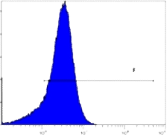
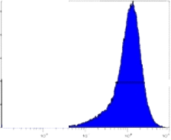
Normalization of Signal
Notes:
Suppose I use my God’s eye view of what’s going on in two samples of bacteria encoding RFP. On the left, the cells are much more fluoescent than those on the right. On two different days, I run one of the samples on the cytometer and collect a histogram.
*
Surprisingly, the instrument is telling me that the cells on the right are more fluorescent than those on the left. The problem here is that the sensitivity of the instrument will drift over time. There are dials you can tune that can make the signal be any number you want it to be. Thus, you must in some way standardize the signal to get consistent measurments across experiments.

Slide 21
Normalization of Signal
Notes:
For cytometry, this normalization is typically done by comparison to cells that lack the fluorophore, such as unmodified bacteria grown under similar conditions to the test sample. You run the white cells through the cytometer then adjust the gain on the instrument such that the signal is centered in the first decade. You then measure your test samples with these settings.

Slide 22
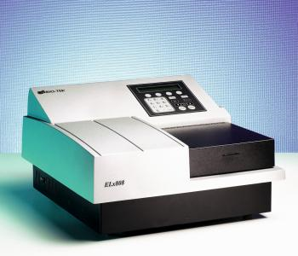
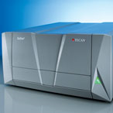
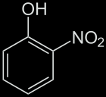
Spectroscopy
(Ensemble measurement of absorbance or scattering)
Hit it with a band of light at a particular wavelength, measure what is “transmitted” through, calculate the “absorbance”
Requires a chromophore, either a colored product in the cell, or the product of a chromogenic substrate
Scattering is measured the same way as absorbance (the signals are always superimposed)
Based on the deflection of radiation by large(ish) particles
Typically done for bacteria at 600nm, the product of which is an OD_600 measurement, referred to as the “optical density”
Notes:
Though this does not involve fluorescence, another means of using light to make measurments on a cell is to use spectroscopy. Here, you hit a sample with a beam of light and quantify how much comes out the other end. That is its ‘transmittance’ which is inversely related to ‘absorbance’. This measurment requires the use of a chromophore, which means a molecule that absorbs light. A very common fluorophore for such experiments is o-nitrophenol which turns yellow. Cells don’t absorb much yellow light, thus there is little competing signal at this wavelength. Typically o-nitrophenol will be caged with another molecule like phosphate or galactose that prevents the molecule from absorbing light. An enzyme like alkalaine phosphatase or galactosidase can release the alcohol and color results. Thus, the activity of the enzyme in the cell can be monitored by watching the formation of yellow color.
Scattering is a related phenomenon in which light bounces off a particle at a different angle than its incident vector. Experimentally, scattering is measured the same way as absorbance though it is a distinct phenomenon. In spectrometric measurements of cells, the scattering signal will be superimposed over the absorbance signal, and the two signals are additive. The scattering signal can be isolated by monitoring the cells at 600nm, and this is referred to as the sample’s ‘optical density’. It is linearly related to the concentration of cells in the sample.

Slide 23
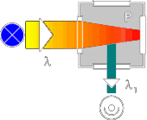
Fluorimetry
(Ensemble measurement of fluorescence)
Hit it with a band of light with one color at the “Excitation Wavelength,” monitor the “Emission Wavelength”
Requires a small molecule fluorophore or fluorescent protein
There is always an autofluorescence background that can mask low signals
Requires normalization of signal optical density
Notes:
Fluorimetry is highly related to spectroscopy, and a fluorimeter can also perform absorbance measurements. In spectroscopy, we hit with one wavelength and monitor the amount of light coming through the sample. In fluorimetry, we hit with one wavelength and monitor the light emitted at 90 degree angle to the incident beam and at a higher wavelegth. Thus, there is an excitation wavelength at which we probe the sample, and an emission wavelength at which we observe the response. Such experiments require the presence of a small molecule fluorophore or a fluorescent protein. Like chromophores, these molecules absorb light. However, instead of simply irradiating heat, these molecules release the energy as photons of higher wavelength. Cells contain some mildly-fluorescent fluorophores such as tryptophan which produce a background signal in these measurements. This autofluorescense can mask low signals. Like cytometry and microscopy, you must normalize the signal against some standard such as white cells in fluorimetry and spectrometry. Additionally, you must normalize for cell density.

Slide 24
Normalization for OD
(Optical Density, for ensemble measurements)
Fluorescence 0.86 0.42
OD_600 0.44 0.22
Ratio 2.0 1.9
Notes:
Consider I have these two samples containing the same bacteria. The only difference is that the cells on the left are twice as concentrated as those on the right. Fluorescence measurments are linearly related to concentration, thus the sample on the left will give twice the signal as those on the right. If you take those numbers at face value, you would incorrectly conclude that the cells on the left are more fluorescent than those on the right. * So, you must normalize for cell density. This is most easily obtained by measuring the optical density, or OD, which is the absorbance at 600nm caused by scattering. That signal is linearly related to the concentration of the cells. Thus, the ratio of these two values will reflect the per-cell fluorescence.

Slide 25
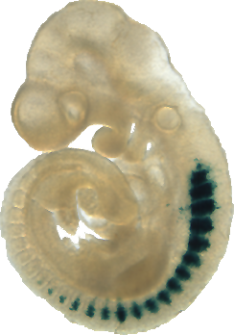
Biochemical Assays
Notes:
Biochemical assays involve the quantification of specific biochemicals or the monitoring of specific biochemical reactions in a cell. The image here is of a mouse embryo in which the lacZ protein is produced in developing cells of the spinal cord. LacZ is one of the biochemical reactions that can be easily monitored using one of these assays. The compound Xgal will turn blue in its presence allowing the staining of cells that express it.

Slide 26


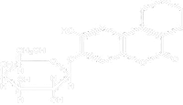

Enzymatic Reporter Assays
β-galactosidase (lacZ)
Alkaline Phosphatase (phoA)
β-lactamase (bla)
Fluorogenic substrate
Xgal (blue)
oNPG (yellow)
Sgal (black)
Notes:
LacZ is one of the most commonly used biochemical assays. It has many variants, and each differs by the type of instrumentation used for the measurement and the specific compound employed. In each case, the b-galactosidase protein encoded by lacZ will hydrolyze galactose residues off the substrate. There are substrates that will turn blue, yellow, or black upon hydrolysis. There are also fluorogenic substrates that that can be detected by cytometry, fluorimetry, or fluorescence microscopy after hydrolysis.
If you just replace the galactose moiety with phosphate, all the same color-generating chemicals can be used to monitor alkaline phosphatase activity. Though the same diversity of substrate does not exist for b-lactamase, a limited set of fluorogenic and chromagenic substrates including nitrocephin exist here too. These enzymatic reporter genes are often used in the same context as GFP and RFP. The measurements are often more precise and sensitive due to the amplification obtained from watching conversion of a substrate rather than the protein itself. For example, to get 100x over background signals from GFP in E. coli, you typically must express it from a high-copy plasmid. However, genomically-encoded LacZ can provide 10,000-signals over background.

Slide 27
Enzymatic Reporter Assays
Involves introducing a substrate compound to the cells or a partial lysate of the cells
Readout can be absorbance, fluorescence, electrochemical (etc.) based on the choice of substrate
Fluorogenic substrate
Xgal (blue)
oNPG (yellow)
Sgal (black)
Notes:
Many of these chromagenic and fluorogenic substrates are cell permeable, and there are additional chemical modifications that can render them cell permeable when they are not. Thus, you often can perform these assays directly on intact cells. Alternatively, they can be performed in a partial lysate of the cells.
Different substrates are read out in different ways. For bulk absorbance measurmenets using a spectrometer, o-nitrophenol based substrates are usually the best. For visual readout on colonies in a plate, the insoluble products of Xgal and Sgal are best. For cytometers, fluorimeters, or microscopy, the fluorogenic substrates are required. Additionally, there are substrates for these enzymes that change electrochemical properties upon hydrolysis allowing detection with electrodes.
I highlight the enzymatic assays because they are commonly used, and there many of them. There are assays for monitoring MAP kinases, for monitoring calcium concentrations, for watching protein:protein interactions, etc.

Slide 28

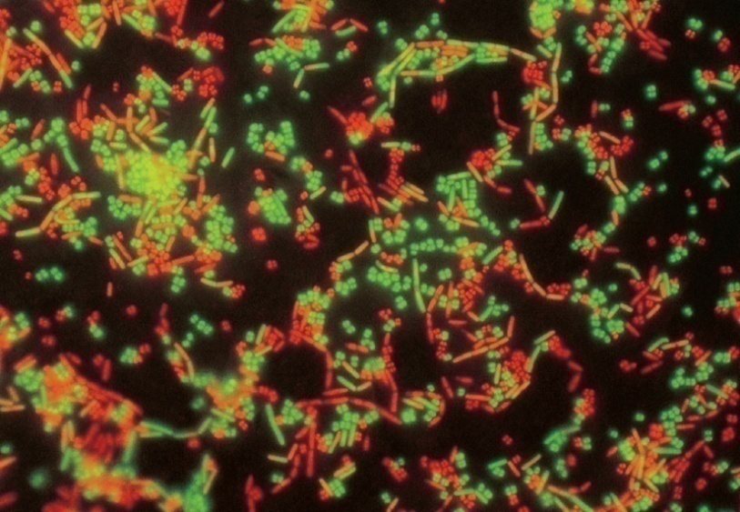
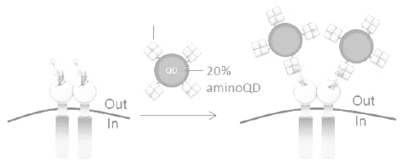
Staining Measurements
Stains specifically label some biochemical species of a cell, or are used as a probe of permeability or the chemical environment of a cell (pH detection, calcium detection, etc.)
Can stain things on the surface of the bacterium (displayed epitopes, proteins) with conjugated antibodies
Can stain microbiological biochemicals (flagella, pili, carbohydrates) with lectins or antibodies
Can do chemical stains (gram staining)
Live-cell impermeable propidium iodide
All-cell permeable SYTO® 9
A staining proceedure with single-cell fluorescence readout (cytometry or microscopy) for determining the percentage of live bacteria in a population
Antibody
Notes:
Another type of biochemical assay involves stains. Stains specifically label some biochemical species of a cell, or are used as a probe of permeability or the chemical environment of a cell (pH detection, calcium detection, etc.) You can stain things on the surface of the bacterium such as displayed epitopes and surface proteins with conjugated antibodies. These are reagents constructed from fluorophores and antibodies chemically linked together. They will stain the cell by specific binding to the epitope on the surface of the cell. You can quantify the staining by any of the various fluorescence methods. You can also stain microbiological biochemicals on the cell surface such as flagella, pili, and carbohydrates using lectins or antibodies. Lectins are binding proteins like antibodies that bind to specific carbohydrate patterns. There are also more general stains, such as gram stain, that will light up the peptidoglycan and stain many cells generally.
*
Another general-use staining strategy is to combine cell permeable and impermable dyes. In the Live/Dead baclight kit, a live-cell impermeable dye called propidium iodide is mixed with a cell permeable dye called SYTO9. Only the dead cells will pick up the propidium iodide, but all cells get syto9. Based on the ratio of the two dyes in the cell, you can tell if the cell is alive or not. That measurement is done by any of the various fluorescence methods, but most typically cytometry or microscopy.

Slide 29
…but be careful!
Bacteria are different sizes at different stages of the growth phase
Replication, Transcription, and translation rates are different at different stages of the growth phase
Toxicity in a cell can increase or decrease the normalized activity observed in a cell
The “proper” way to handle the data for such experiments is debatable. DON’T GET FANCY WITH THE MATH!
Notes:
There are a number of things you should be careful about when performing biochemical assays that have quantative readouts. Bacteria are different sizes at different stages of the growth phase. The process of replication, transcription,a nd translation all have different rates based on the phase of growth, the medium composition, and the genetic composition of your strain. Additionally, the growth conditions or your genetic modifications can differentially affect the growth of specific strains.
These differences in cell physiology and growth rates can play havoc with your experiments. It is very easy to fool yourself into thinking a genetic device is working when in reality it is an artifact of the growth conditions. It is tempting to do extensive data manipulation to control for deviations in your experiment. There are many notable examples of scientists performing elaborate corrections to their data that make small differences in original signal look far more dramatic. Such manipulation is highly discouraged since it is difficult to justify these corrections. Best practice is to normalize for cell density and for signal strength against a standard, but nothing else. This does not guarantee that your data will not lie to you, So, be careful, and be cautious in your conclusions.

Slide 30
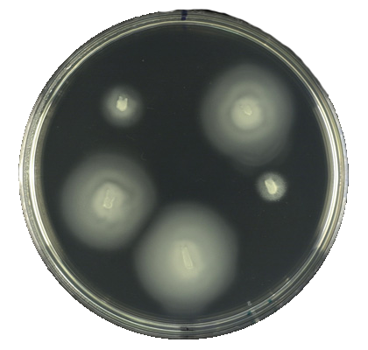
Microbiological Assays
Notes:
Microbiological assays are whole cell assays that monitor some non-chemical process in the cell.

Slide 31
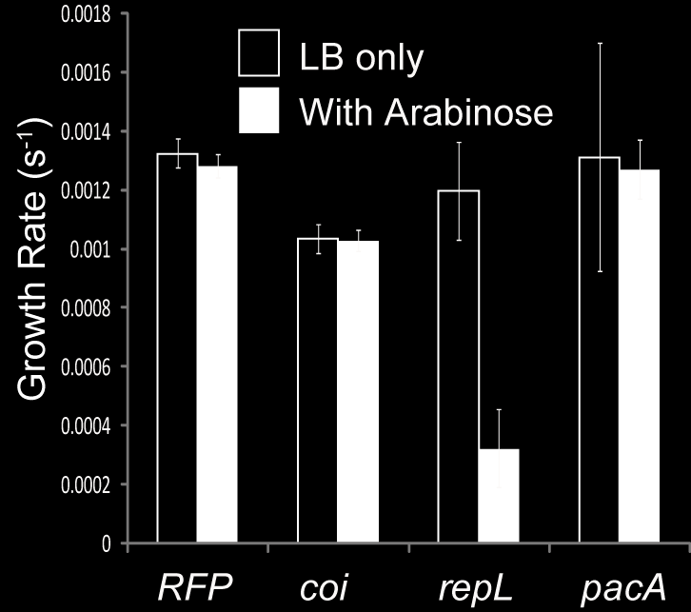
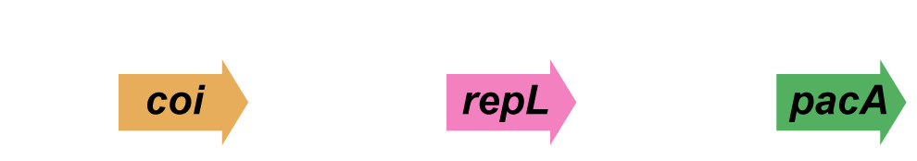
Measuring Toxicity
Following OD_600 over time provides a growth rate. When compared to wild-type cells, toxicity can be inferred.
Notes:
Cell growth is one such phenomenon. By measuring optical density as absorbance at 600nm, you can follow the growth a cell culture over time. The first derivative of this trace is the growth rate. In this experiment, we individually place three different protein components of a genetic device under the Pbad promoter and monitor the cells growth as a function of time with and without arabinose induction. An examination of the growth rates shows the RepL is clearly toxic to the cell upon induction, and this knowledge is useful for debugging the circuit.

Slide 32
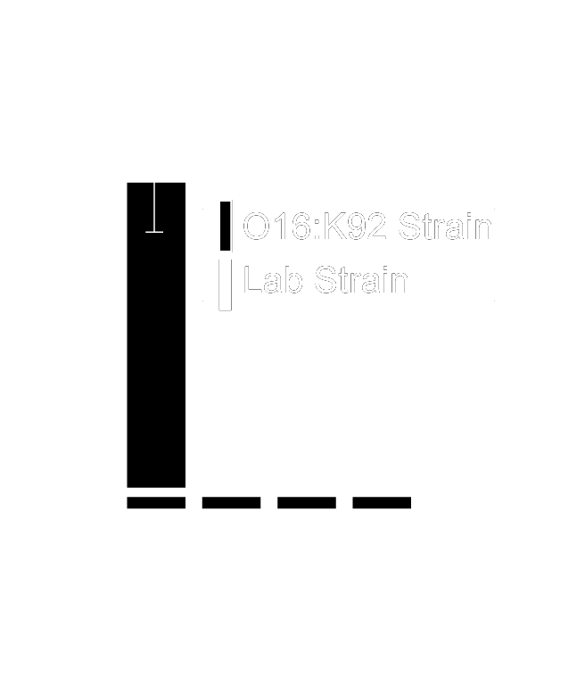
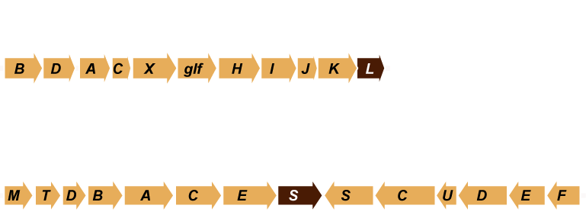
Devices affecting viability
In this experiment, bacteria are incubated in horse serum and then plated on LB plates
Colonies are counted and plotted
Mammalian serum (non-cellular component of blood) contains complement. It kills bacteria.
Introduction of K92 and O16 devices place carbohydrate polymers on the surface of E. coli and mask the surface
Notes:
Genetically-encoded processes have naturally evolved to improve the fitness of their organism in some environment. By placing the organism in this environment you can monitor the function of the process by virtue of the organism’s growth. Here we are monitoring the expression of capsular polysaccharides which are * encoded by two large gene cluster. When all these genes are expressed with the right timing, localization, and concentration, the surface of the bacterium becomes heavily decorated with carbohydrates that affect immunological properties of the bacterium. These modifications allow the bacterium to survive in horse serum. Horse serum, or the non-cellular component of adult horse blood, contains complement which will quickly kill a non-encapsulated bacterium. However, with a complete set of functioning genes, viability is restored.
*
In this assay, we incubate the bacteria with horse serum for some amount of time and then spread the mixture on culture plates. The next day, we count colonies and measure what percentage of the bacteria survived the serum.

Slide 33
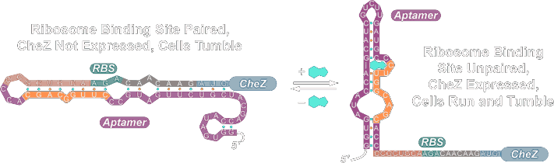
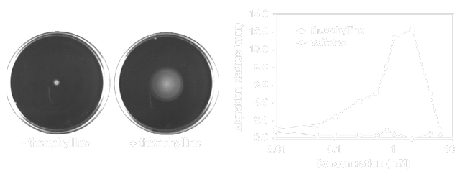
Chemotaxis/Swarming Assays
PMID: 17480075
Notes:
Beyond growth, there are other processes that organisms do that can be monitored to observe the behavior of a cellular process. Here, we look at chemotaxis using a swarming assay. Agar medium is prepared with only a small amount of agar resulting in very soft petri dishes. A small spot of bacteria is placed in the middle of the dish and then incubated for several hours. If the bacteria have intact chemotaxis processes, they will swim outwards from the center of the plate forming a clouding circle. The diameter of the circle is an indirect measure of functionality. In this particular experiment, they have constructed an E. coli strain with an aptamer controlling the CheZ gene. CheZ is a protein required for chemotaxis to happen. By occluding the ribosome binding site in front of CheZ with an aptamer that binds theophyilline, the expression of CheZ is dependent on the concentration of theophylline. Thus, addition of the small molecule results in more effect swarming. By doing this assay with many concentrations of theophylline and the related-but-not-functional compound caffeine, they obtain a transfer function relating input concentration of the molecule to the cells output behavior.

Slide 34
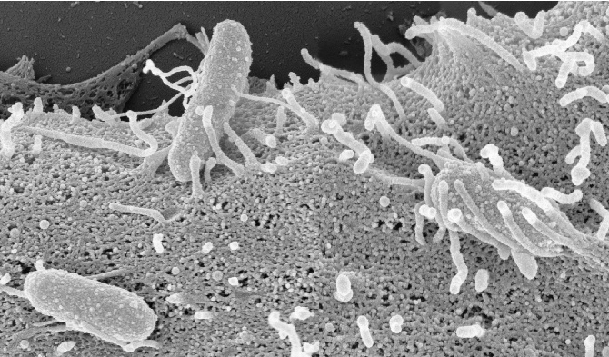
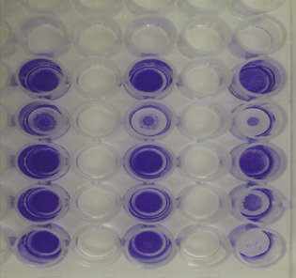
Adhesion Assays
Adhered bacteria are detected by outgrowth (OD measurement) or staining
Binding Substrate (for example: Mannan binds type I pili)
Notes:
Another microbiological behavior is adhesion. Bacteria often stick to surfaces including the surfaces of other cells like human gut epithelial cells Though it is not synonymous with biofilm formation, it is a highly related phenomenon. One way to quantify it involves microplate-based adhesion assays. In this example, we are monitoring the adhesion of bacteria to mannan, a carbohydrate resembling the surfaces of mammalian epithelial cells, via type I pili.
*
We begin with a well of a 96-well ELISA plate. You are looking at the plate sideways-on.
*
To each well we’ll add mannan, and it becomes adhered to the surface. We also block the cells with BSA to prohibit further non-specific binding.
*
We then add the cells of the strain we wish to test.
*
Allow them to adhere, and then wash the unbound cells away.
*
Finally, we stain the cells with gram stain and obtain a measure of cell adhesion in terms of intensity of purple color.

Slide 35
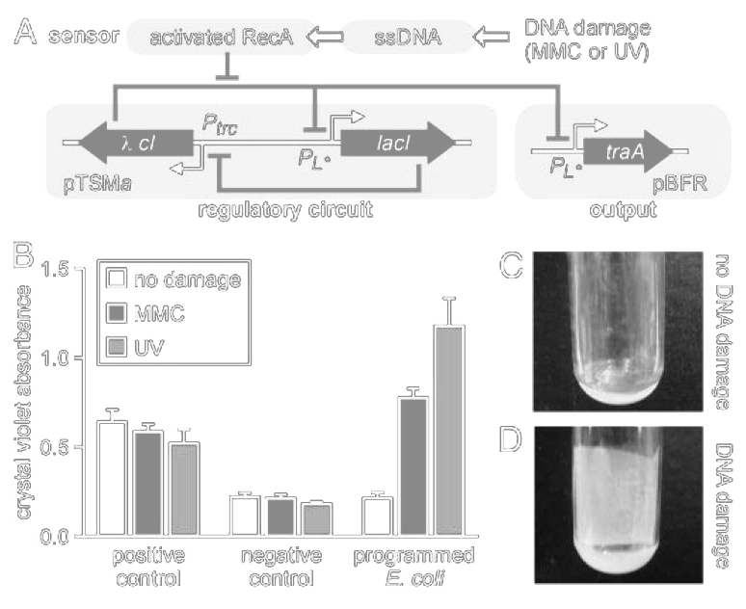
Biofilm Formation
PMID: 15159530
Notes:
Here’s an example of adhesion assays in action from the Collins lab. First, they have the Toggle switch composed of lambda CI and LacI. This switch is full on or off and can be switched between these states. This transcriptional circuit controls expression of the traA gene. In response to DNA damage, the toggle switch flips on, traA is produced, and this complements a missing copy of traA needed for biofilm formation. Thus, DNA damage results in biofilm formation. * To observe this behavior, they treat the bacteria with DNA damaging agents such as UV light or chemical mutagens, and then perform the same crystal violet staining of adhered bacteria as described before.

Slide 36
Experimental Design
Differential Expression
Transfer Functions
Dynamics
Population Heterogeneity
Notes:
Thus far we’ve focused on describing different ways of extracting information about the function of a genetic device in a cell. There are additional considerations such as the choice of controls and choice of experimental conditions that must be including in the Test phase. We’ll describe 4 specific areas of information one needs to extract from an assay. In differential expression, you are comparing a strain’s function under two or more environmental conditions. In a transfer function, you are continuously varying some environmental parameter and trying to produce a function relating the output behavior to this input. Dynamics involves following the system over time with your assay. Finally, population heterogeneity involves performing your assay on individual members of the cell population.

Slide 37
Differential Expression
Example: a magnesium promoter part in LB versus PBS
Differential expression implies there are 2 (or more) conditions, and you want to know whether a device behaves differently under those different conditions
Red Fluorescence Measured by Fluorimetry in Different Media
P_{mgtCB -or-}
P_{phoPp1}
RFP
A magnesium reporter device
Notes:
Differential expression involves performing an assay undeer different conditions. In this example, we are trying to characterize the response behavior of a magnesium-responsive promoter in LB medium versus PBS medium.
*
The genetic construct places the RFP gene under the control of the promoter we wish to test or a control constitutive promoter.
*
Red fluorescence and OD are measured fluorimetrically after growth in different media. The signature of a differential expression experiments is the non-continuous nature of the input variable. In this study, those different inputs are specific medias. In many industrial-scale fermentation processes, these inputs might be different chemical feedstocks. The conditions employed are specific things, and it is not relavent to ask about a condition halfway in between.

Slide 38
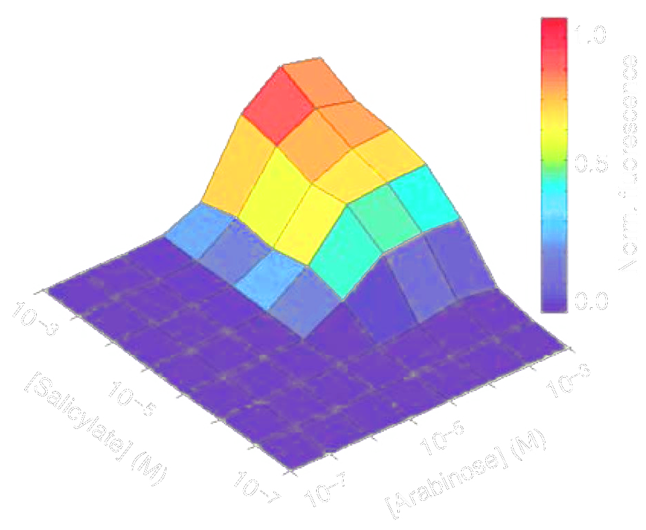
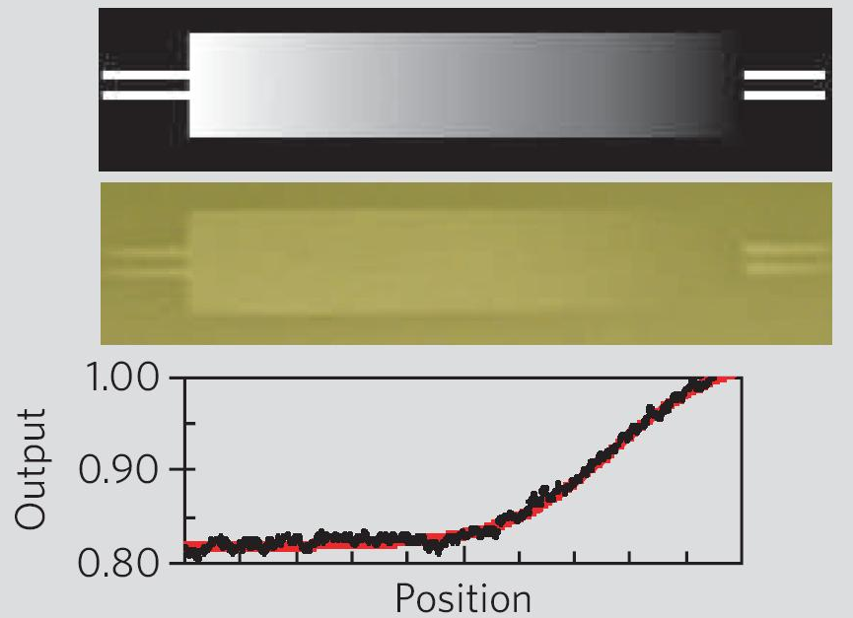
Transfer Functions
Example: arabinose promoter
Like differential expression, transfer functions are a relationship between an input and a measured response
The difference is, the stimulus is graded, so you have a function relating the two
P_{BAD}
GFP
PMID: 17700541
GFP (AU, by cytometry)
[Arabinose] μg/mL
PMID: 16306980
Notes:
A transfer function experiment involves scanning through a continuous environmental variable. In the previous example of the magnesium-responsive promoter, we could grow the cells in LB medium with many different concentrations of magnesium and then plot red fluorescence over time.
*
Here we have the same thing, but a different piece of regulation and a different environmental input. It’s the Pbad promoter now driving GFP instead of RFP, and we are scanning through concentrations of arabinose. It is usually possible to derive kinetic models of regulatory circuits that predict the shape of these functions, and often folks will make these models and then fit the parameters to fit the model. This then allows interpolation to intermediary values for the input.
*
In this example we are showing the response of an AND gate of two different inputs: arabinose and salicylate. Thus, the inputs of a transfer function can have more than one axis.
*
Finally, we have an example of a continuous range of inputs used to construct a transfer function. The cells here contain the light sensor circuit from the Voigt lab driving lacZ. They put a layer of the bacteria on the surface of a petri dish, and then shine light on it through a continuous mask. When the light level is right to turn the system on, lacZ gets produced, and Sgal is turned into a black pigment. They then use image processing to quantify the darkness over the gradient to plot out the transfer function.

Slide 39
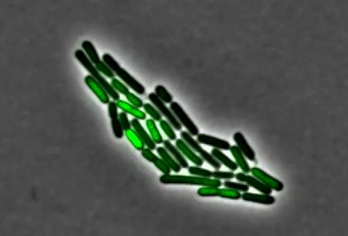
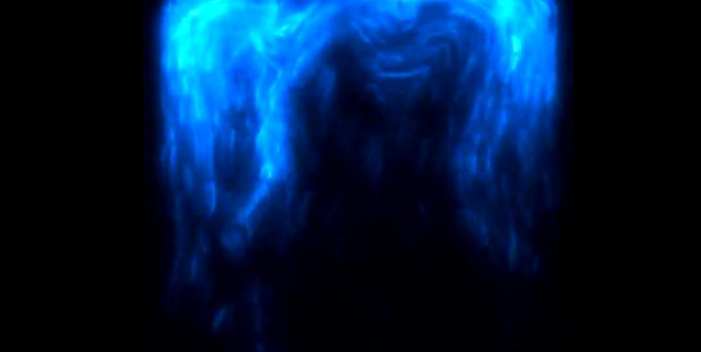
Dynamics
http://www.youtube.com/watch?v=qWkLS-u982A
http://www.youtube.com/watch?v=IknK-7THoIc
Notes:
I’ll show you these two clips after this presentation, but these are two examples of following the dynamics of single cells containing a genetic circuit over time. These oscillating genetic circuits require monitoring the behavior of individual cells over time. Currently, the only way to do this is fluorescence microsopy and thus such assays only work for fluorescence readouts. It would be extremely challenging to, for example, monitor single-cell dynamics of a cell biosynthesizing a biofuel.

Slide 40
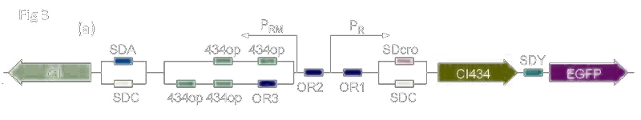
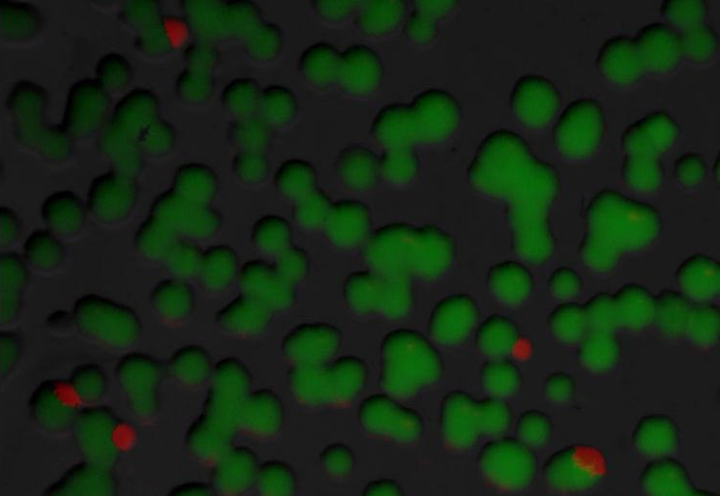
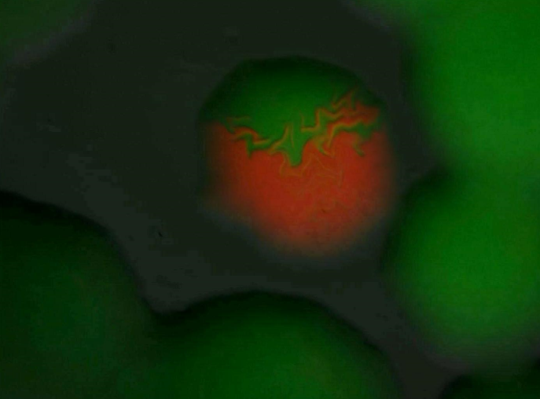
Population Heterogeneity/
Phase Variation
iGEM: Peking, 2007
Notes:
Another measured property of a strain is population heterogeneity. Here, one cell in the population does something different than other cells. Sometimes this is an intentional property. For example, this variant of the toggle switch from the Peking igem team in 2007 is designed to cause population heterogeneity. Thus, they need to look at individual cells in the population and measure two different channels of fluorescence. However, often population heterogeneity is an unwanted and challenging-to-measure property of a strain. For example, you might have a biosynthetic pathway in a cell in which only 10% of the population is producing the genes needed for biosynthesis. With bulk measurements, it is impossible to know that such heterogeneity exists, but it is challenging to decipher this quality of your design directly. If the heterogeneity is due to genetic mutation, this can be pulled out from single-cell sequencing. There are efforts to develop other single-cell assays in the works, but as of 2014, sequencing and fluorescence are the only off-the-shelf way to ask questions about population heterogeneity.

Slide 41
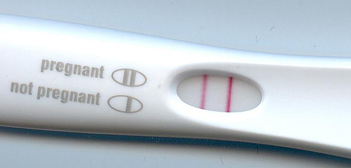
Putting it all together

Slide 42
Say I want to engineer some bacteria that turn red when placed in a sample containing anti-HIV antibodies. I’ve broken the problem down to several devices:
An HIV gp120 peptide-based sensor device with a transcription output (environment in / PoPS out)
Maybe a genetic circuit to amplify the signal based on a sender/receiver system (PoPS in / PoPS out)
A red pigment biosynthetic device for detection (PoPS in / chemicals out)
PMID: 18776022

Slide 43
Say I want to engineer some bacteria that turn red when placed in a sample containing anti-HIV antibodies. I’ve broken the problem down to several devices:
An HIV gp120 peptide-based sensor device with a transcription output (environment in / PoPS out)
Maybe a genetic circuit to amplify the signal based on a sender/receiver system (PoPS in / PoPS out)
A red pigment biosynthetic device for detection (PoPS in / chemicals out)
AHL (acyl homoserine lactone)
luxR
luxI
PluxI
PMID: 18776022

Slide 44
Say I want to engineer some bacteria that turn red when placed in a sample containing anti-HIV antibodies. I’ve broken the problem down to several devices:
An HIV gp120 peptide-based sensor device with a transcription output (environment in / PoPS out)
Maybe a genetic circuit to amplify the signal based on a sender/receiver system (PoPS in / PoPS out)
A red pigment biosynthetic device for detection (PoPS in / chemicals out)
PMID: 18776022

Slide 45
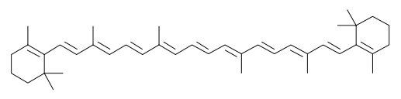
Say I want to engineer some bacteria that turn red when placed in a sample containing anti-HIV antibodies. I’ve broken the problem down to several devices:
An HIV gp120 peptide-based sensor device with a transcription output (environment in / PoPS out)
Maybe a genetic circuit to amplify the signal based on a sender/receiver system (PoPS in / PoPS out)
A red pigment biosynthetic device for detection (PoPS in / chemicals out)
carA
carB
carC
PluxI
PMID: 18776022

Slide 46
The System with Devices
Gp120 Sensor
LuxI Sender
Anti-HIV Antibody
PoPS
AHL
LuxR Receiver
LuxI Sender
AHL
PoPS
AHL
LuxR Receiver
Carotenoid Biosynthesis
PoPS
AHL
PMID: 18776022

Slide 47
Sensors
Sensing Device
Gp120 Sensor
GFP
Anti-HIV Antibody
PoPS
Receiver Device
LuxR Receiver
GFP
AHL
PoPS
PMID: 18776022

Slide 48
Actuators
Pigment Device
Pbad
Carotenoid Biosynthesis
PoPS
Arabinose
Red Pigment
Sender Device
Pbad
LuxI Sender
PoPS
Arabinose
AHL
PMID: 18776022

Slide 49

Questions to Ponder

Slide 50
What type of experiment should I do to characterize the pigment device?
What type of experiment should I do to characterize the sender device?
What type of experiment should I do to characterize the receiver device?
What type of experiment should I do to characterize the sensing device?
If I succeeded in building this system, what type of experiments should I do to characterize the system?
What kind of demonstration experiment should I do to show that this thing works and is useful?

